Slide 1
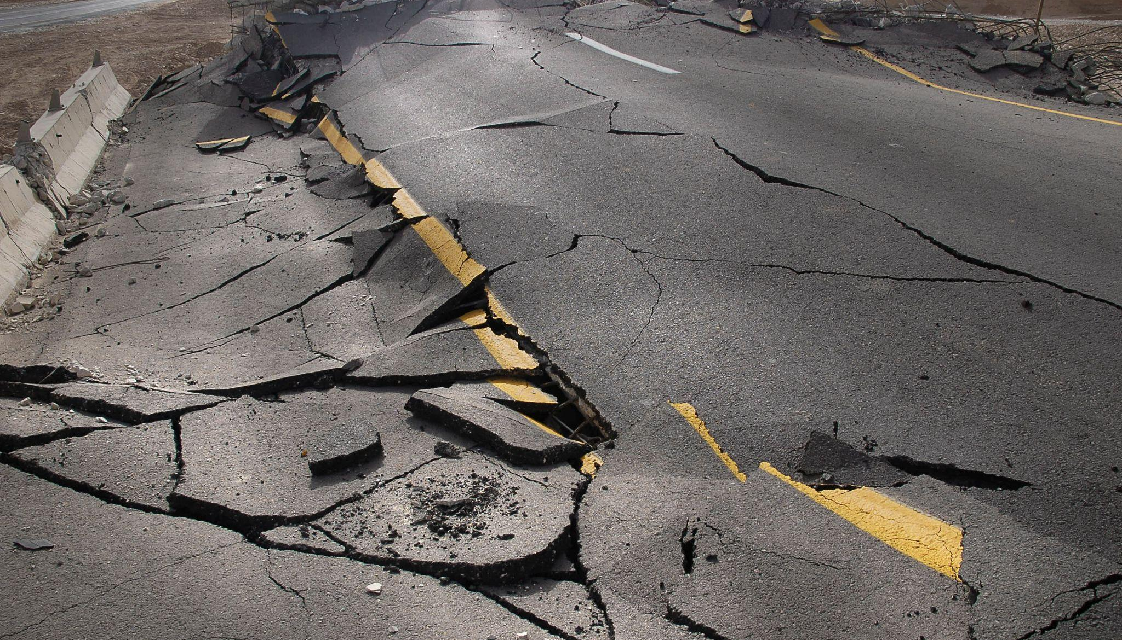
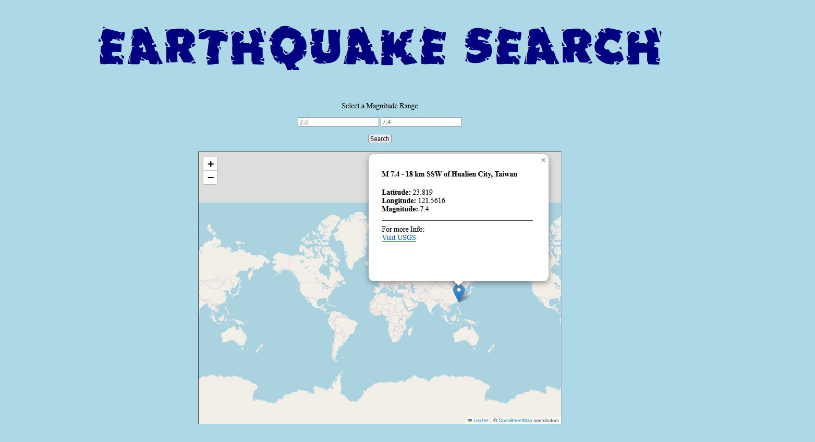
Global Earthquake Visualization Tool
Presented by Team 8:
Adrian Dayrit, Robert Rose, Cataldo Cocuzza, Fay Muhammad, Kefan Liao and Christopher Scarlata
Source: USGS - Science for a Changing World

Slide 2

Agenda
01
Project Overview – Chris
04
Demo – Robert
02
Data Overview – Adrian
05
Future Enhancements – Fay
03
Visualizations – Cataldo
06
Ethical Considerations – Kefan

Slide 3

Project Overview
To provide a 30-day overview of earthquake activity throughout the world.
Where do they occur and with what frequency?
How are earthquakes recorded and measured?
How is an earthquake’s magnitude determined?

Slide 4


Data Overview
Data source:
United States Geological Survey (USGS)
Total records: n = 1353
Data attributes: n = 31
ID: Unique identifier for each seismic event (string)
Magnitude: Richter-scale measure of the earthquake’s strength (decimal)
Latitude: geographic N-S coordinate (decimal)
Longitude: geographic E-W coordinate (decimal)
Time: Timestamp of earthquake occurrence (long integer)
Felt: number of reports from people who felt the earthquake (integer)
Sig: measure of earthquake’s significance; scale 0 -1000 (integer)
MMI: measure of earthquakes effects on Earth’s surface (decimal)
Data range: Last 30 days
Tools Used:
GeoJSON Data
Python
Flask
PyMongo
Folium
MongoDB
HTML/CSS

Slide 5
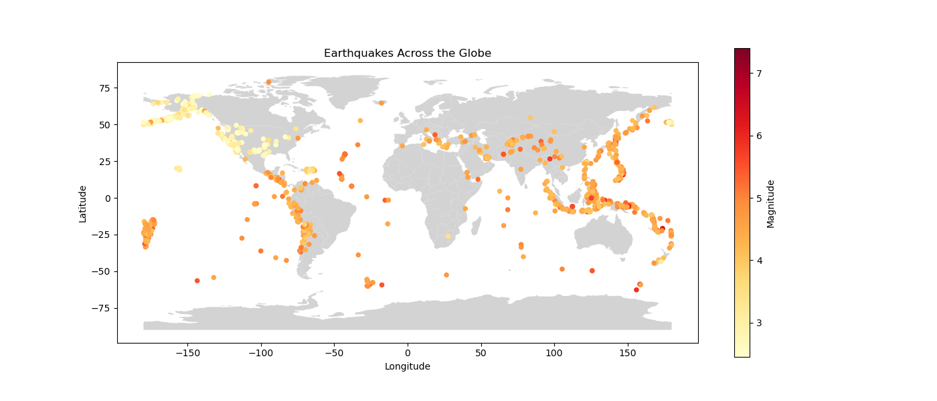
Dot Distribution Map
Notes:
Worldwide occurrence of earthquakes; dots are color-c

Slide 6
DEMO

Slide 7

Future Enhancements
Broaden Query Features
Enable search by location, date range, and other parameters
Extend data range beyond 30 days for historical analysis
Improving Safety and Education
Setup real-time, custom alerts based on user preferences
e.g., Location, Magnitude Range
Share safety information
e.g., How to prepare for an earthquake? What to do during an earthquake? What to check for after an earthquake?
Translate magnitude scale into easily understandable terms
e.g., What does a 4.8 magnitude practically mean?

Slide 8

Ethical Considerations
All data gleaned from the United States Geological Survey (USGS) website.
The dataset includes geographic information, including latitude, longitude, magnitude, and other relevant data.
The data is generated from the global and national seismic network.
The data presented provides a 30-day overview of earthquake activity throughout the world.
The dataset does not contain any personally identifiable information (PII).
Notes:
All the data were collected from United States Geological Survey (USGS) website which is openly available to the public. The dataset includes geographic information such as latitude, longitude, magnitude, and other relevant data. According to USGS, the data is generated from PAGER (Prompt Assessment of Global Earthquakes for Response), an automated system that processes seismic data from remote sensors worldwide. We gathered the data to provide a 30-day overview of earthquake activity through the world. The dataset does not contain any personally identifiable information (PII).

Slide 9
Questions?

